Slide 1

Customer Churn Prediction
An End-to-End Data Science Solution
Henry Dibie
Notes:
Good morning/afternoon. My name is Henry Dibie. Today, I'd like to walk you through a project I built to address a critical business problem: customer churn.

Slide 2
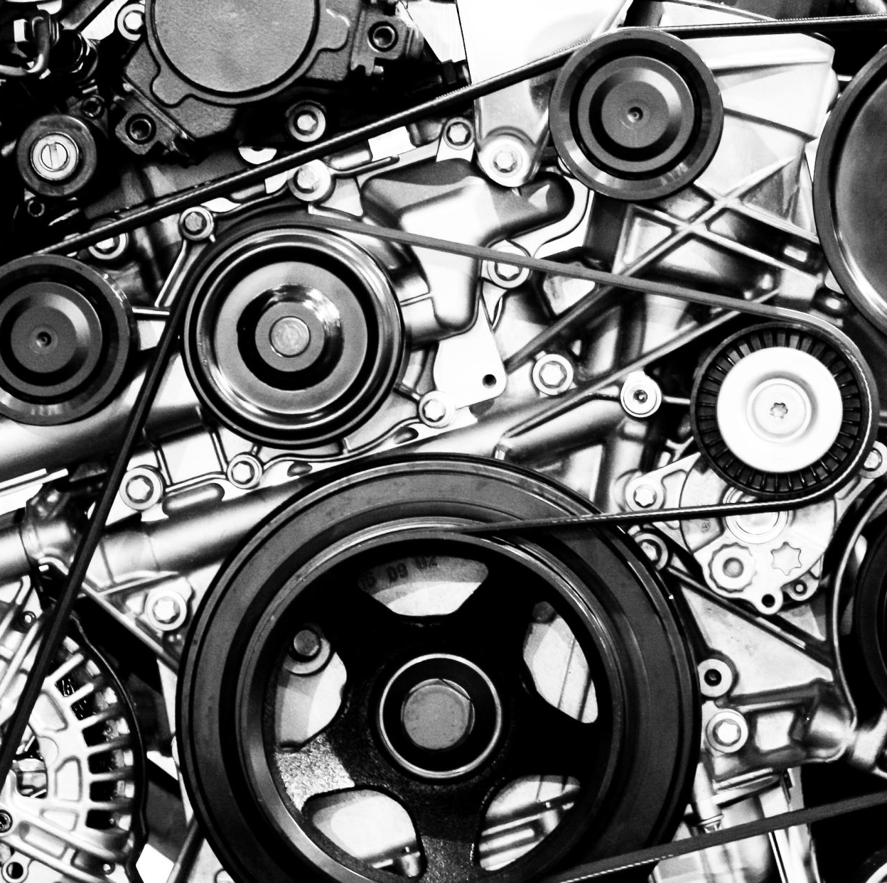
The Business Problem
The Challenge: The Leaky Bucket
Customer churn is a silent drain on revenue.
The goal was to move from a reactive approach (addressing churn after it happens) to a proactive one (predicting who will churn and why).
My solution provides a predictive engine and a dynamic dashboard to address this.
Notes:
Every business struggles with customer churn. I call it 'the leaky bucket' problem. My project's goal was simple: to build a solution that could predict which customers were most likely to leave, giving the business a chance to retain them.

Slide 3

My Solution: The End-to-End Pipeline
My Approach: A Full-Stack Data Science Pipeline
Phase 1: Analysis & Modeling (Python)
- Exploratory Data Analysis (EDA)
- Data Preparation & Feature Engineering
- Predictive Modeling (Logistic Regression)
Phase 2: Actionable Insights (Power BI)
- Production-Ready Scripts (predict.py)
- Interactive Business Dashboard
Notes:
I took an end-to-end approach, building a complete pipeline. It starts with a predictive engine in Python, where I trained a machine learning model, and it ends with a final, professional dashboard in Power BI, which is the product the business would use.

Slide 4

Exploratory Data Analysis (EDA)
Exploring the Data
Churn Distribution: The dataset shows a balanced churn rate, with 46.6% of customers churning.
Key Finding 1: Customers who churned had a lower total number of orders and lower total spent compared to retained customers.
Key Finding 2: Order_frequency was a strong indicator of churn. Retained customers tended to have a higher frequency of orders, suggesting regular engagement is a critical factor.
Notes:
Before building a single model, I performed extensive Exploratory Data Analysis. This is where I found the key insights that would power the rest of the project. I discovered that customers who churned tended to have lower order frequency and lower total spending, which told me what features were most important to engineer for the model.

Slide 5
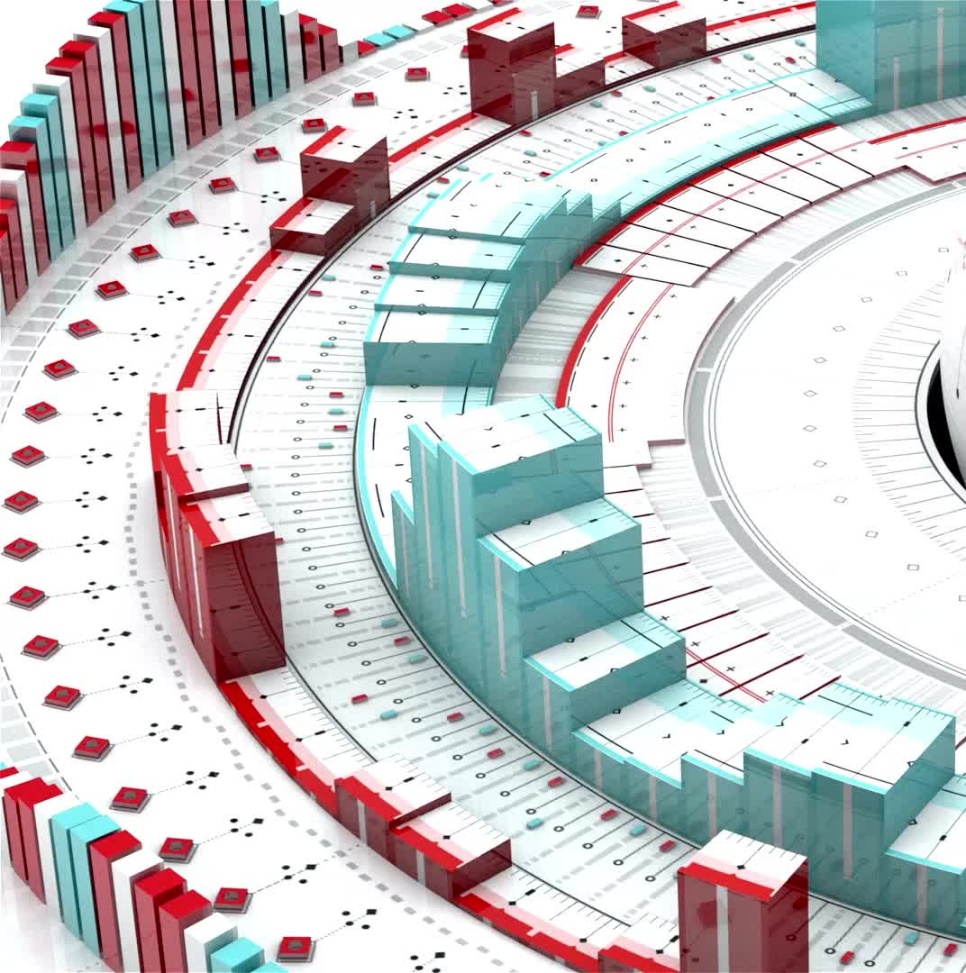
The Predictive Model
The Predictive Engine: Finding the Best Model
Engineered key features like Recency and Order Frequency.
Trained and evaluated Logistic Regression, Random Forest, and XGBoost.
Final Model: Logistic Regression, with an ROC AUC of 0.763.
- Excellent performance for a real-world problem.
- Chosen for its balance of accuracy and interpretability.
Notes:
The core of the project is the predictive model. I engineered features to capture customer behavior. After testing a few models, I chose Logistic Regression. Its ROC AUC score of 0.763 is considered a very strong result for predicting human behavior, and it allows me to explain the predictions easily to stakeholders.

Slide 6

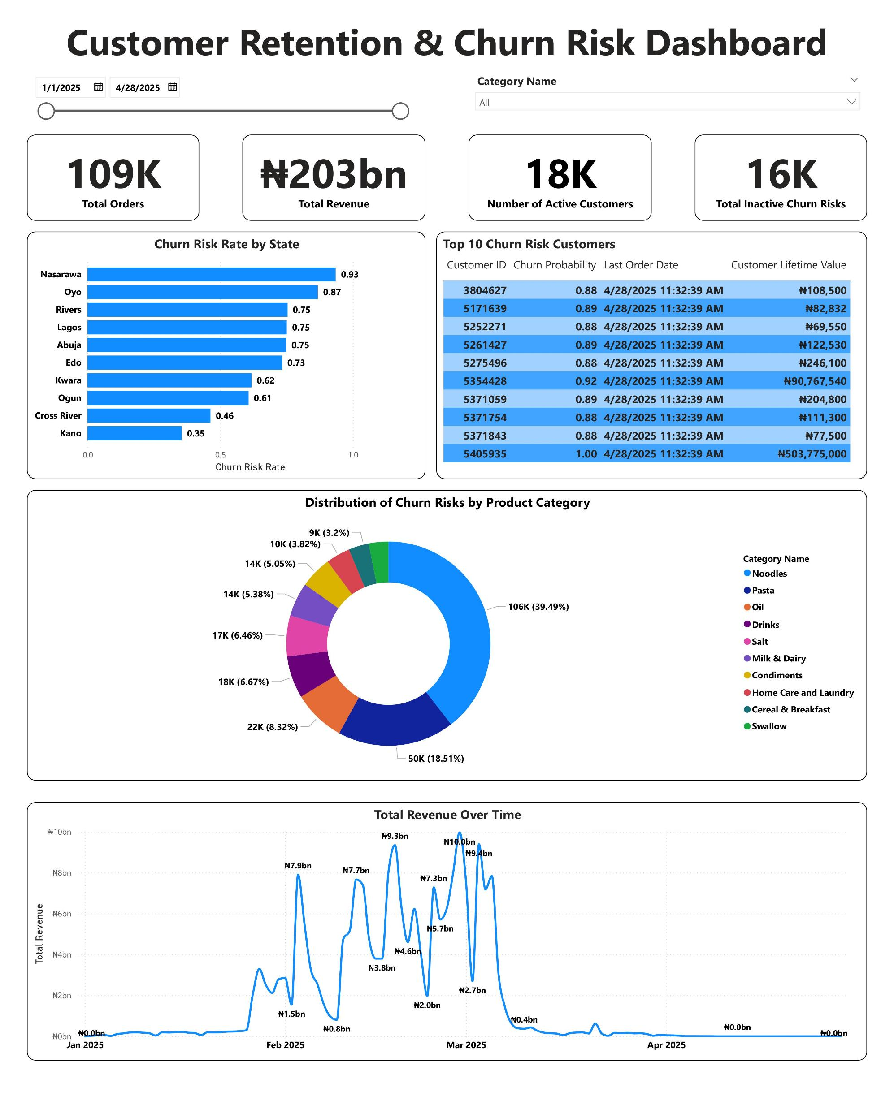
The Final Product: The Dashboard
The Final Product: A Live Dashboard for Business
Notes:
This is the final product. It connects my predictive model to the business team. The dashboard is interactive, allowing them to filter and explore insights on their own. It provides a single source of truth for all of our customer retention efforts.

Slide 7
The Actionable Insights
High-Level: 16K customers are considered inactive churn risks, with an overall churn risk rate of 89%.
Geographical Risk: Top 3 states with the highest churn risk are Nasarawa, Oyo, and Rivers.
Product Risk: The highest-risk product categories are Noodles and Milk & Dairy.
Actionable List: The dashboard provides a prioritized, real-time list of top customers to target for retention.
Notes:
This slide shows the real value of the project. We can see high-level metrics, but we can also get granular. The dashboard identifies which states and products are most affected and, most importantly, provides a prioritized list of specific customers for the sales or marketing team to reach out to. The currency format on Customer Lifetime Value also makes it easy to understand the potential value of each customer they save.

Slide 8
Conclusion & Q&A
Project successfully built a complete, end-to-end data science solution.
The solution is production-ready and scalable for live data.
It bridges the gap between technical analysis and business strategy.
Q&A?
Notes:
In conclusion, this project demonstrates my ability to take a business problem and deliver a complete, actionable solution. The pipeline is designed to be modular and ready for deployment in a real-world environment. I'd be happy to answer any questions you have.

